Slide 1


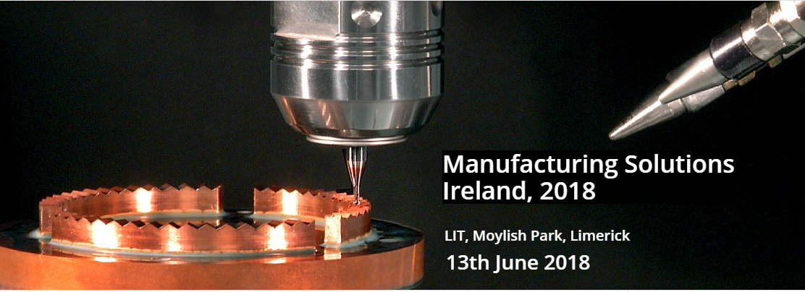



MANUFACTURING SOLUTIONS 2019
Manufacturing Solutions
Ireland 2019
LIT, Moylish, Limerick
12th June 2019
http://manufacturingsolutions.ie/

Slide 2
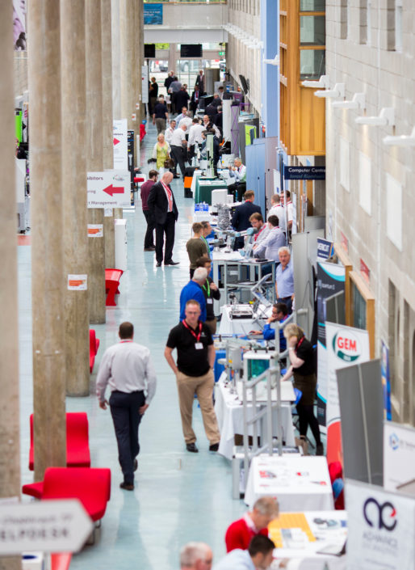
MANUFACTURING SOLUTIONS 2019, June 12th
100+ Trade stands
20 PTMA stands
£600 for a 3 x 2 metre stand
Industry Speakers
CNC demonstrations
Engagement with the British Embassy
Open to Ideas to increase participation

Slide 3

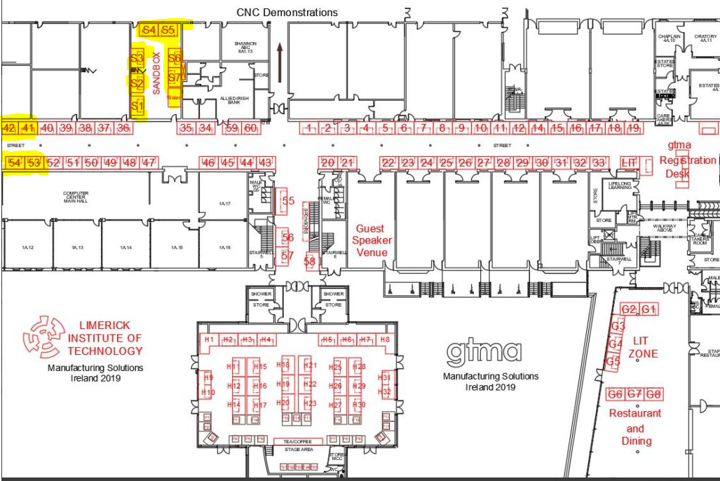
Manufacturing Solutions 2019

Slide 4
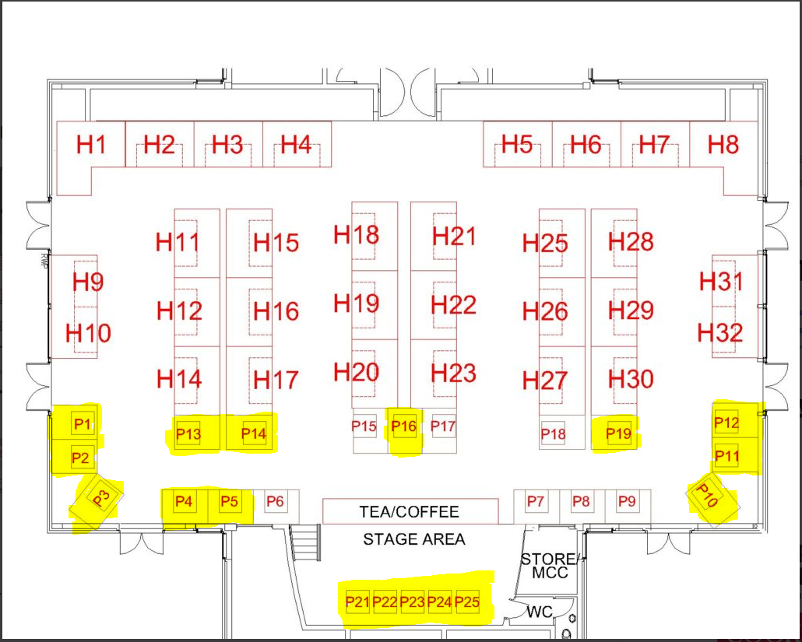
Manufacturing Solutions 2019
P1
P2
P3
P4
P5
P6 Panalok
P7 GW Lisk
P8 Almir
P9 Ashleigh Eng.
P10
P11
P12
P13
P14
P15 Takumi Precision
P16
P17 Formtech
P19 Portasol
P19
P20

Slide 5
Manufacturing Solutions 2019
PTMA Company Zone
A PTMA zone for the event with signage over head to indicate the presence at the event.
1 metre x 1.5 metre stand @ £300 (note sterling; approx. €330)
PTMA signage at the street directing people to the Hall
Two lunch vouchers
Located near Tea/Coffee.
  Over 1000 Teas/Coffees were consumed last year
1 metre x 1 metre or 1 metre round table and chairs, Table cloth
Space at the rear of the stand for Pull Up banners
Power supplied to each table (bring your own extension lead).
Hall will be carpeted like last year.

Slide 6
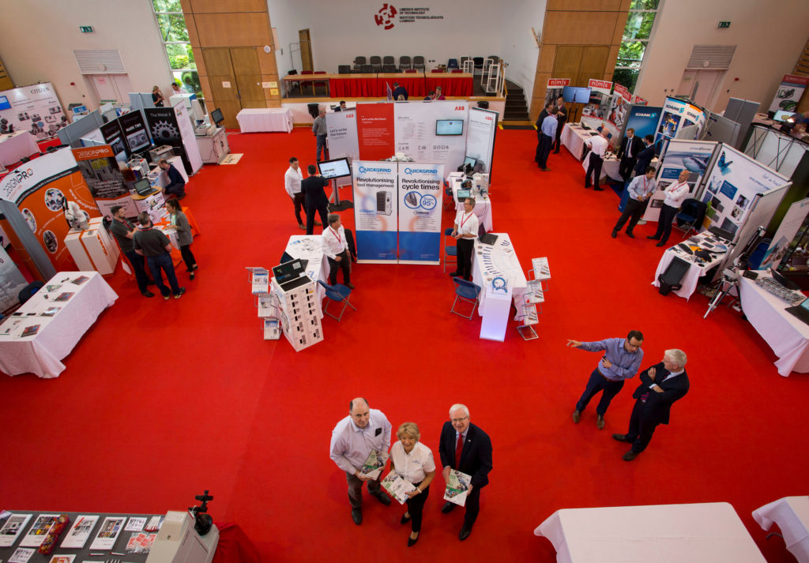
Manufacturing Solutions 2019

Slide 7
How it will work:
PTMA to offer space on their zone at £300.00 per space (note sterling) to Full Members
GTMA will invoice each PTMA member for payment and chase insurance documents etc.
PTMA members not settling their invoice or providing documents the GTMA will be given to LIT a list of those companies for PTMA to chase
At the end of the show, LIT will invoice GTMA for costs.
  There may be additional spaces on the stage, but these may not be as attractive.

Slide 8
Manufacturing Solutions 2019
June 12th
  100 Trade stands and 20 PTMA stands
  Department of Trade and Industry
    Engaged with the British Embassy
  Meet the Buyer.
    European Enterprise Network NI to manage
    Working on 8 to 10 buyers
  Energy in Industry:
    One day conference
  CNC demonstrations.
    Exploring this avenue
  Emerald Aero Group meeting in LIT

Slide 9
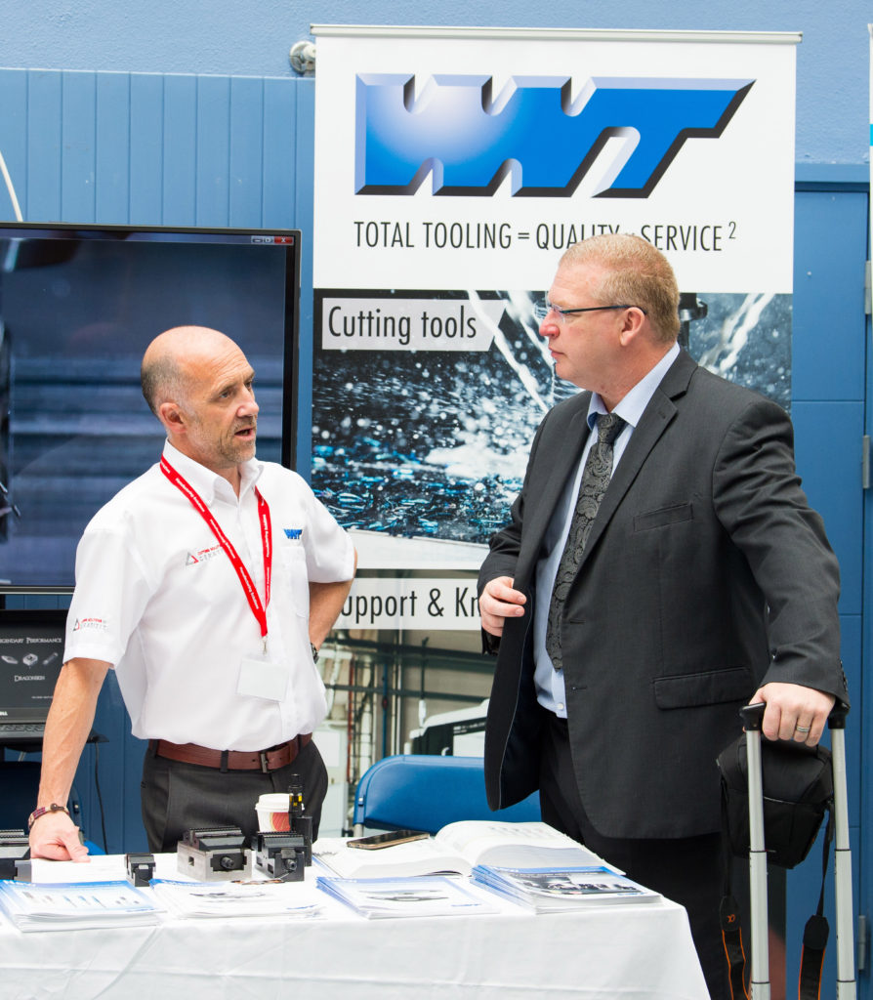
PTMA Zone
Typical PTMA Stand layout
Pop up banner
Personal Touch
Interesting Products
Unique Services
Key message to visitors

Slide 10
MANUFACTURING SOLUTIONS 2019
Manufacturing Solutions
Ireland 2019
LIT, Moylish, Limerick
12th June 2019
http://manufacturingsolutions.ie/

