Slide 1

Limerick Institute of Technology
LIT & PTMA Relationship in developing the Precision Engineering Courses
Ciarán O’Loughlin
Precision Engineering Programme Leader
Lecturer
Department of Mechanical and Automobile Engineering.

Slide 2
Programme Structure: response to Industry
Level 8
B. Eng. Hons Precision Eng. Add-on
Level 8 Precision Engineering
Ab-initio
CAO
Year 4
Level 7
B. Eng. Precision Eng. Add-on
Level 7
B. Eng.
in Precision Engineering
CAO
Year 3
Conversion Modules
Level 6 Proposed Apprenticeship
Precision Machinist and Quality Control
Level 6 Higher Certificate in Precision Engineering
Year 2
Year 1

Slide 3
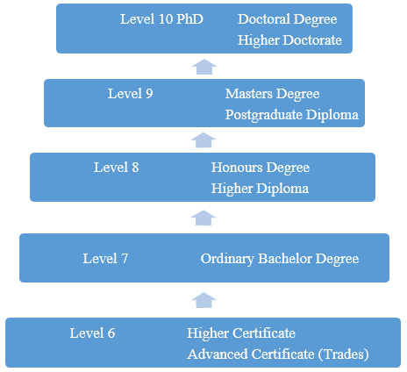
Irish Education System: Context
Third Level College:
  Universities (7 in Ireland)
  Institutes of Technology (14 in Ireland)
    Move towards technical Universities
Second level School:
  Age 12-18
  Typically 7 subjects; 3 mandatory subjects
Primary School:
  Age 5 to 12
  Broad curriculum

Slide 4
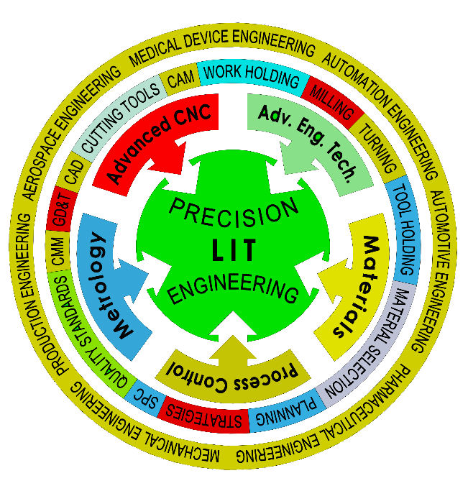
Precision Engineering

Slide 5
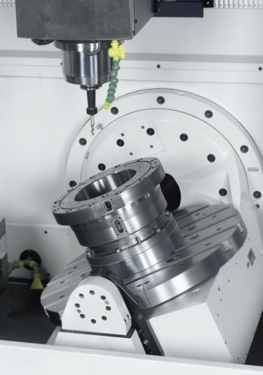
The Industry problem
PTMA and Enterprise Ireland identified common problems.
Skills shortage in Industry
Lack of supply of new Engineers for this sector
Lack of opportunity for progression in Education
Need for engineers and technicians to meet growth, replacement staff and retirements.
New technology introduction and adoption
New programme development!

Slide 6
  Challenges facing the Precision Industry Today
Rapidly changing technologies require higher levels of specifically trained Engineers. Some examples.
Tooling
Metrology
Safety
Precision Engineer
Lean
Quality
CNC Programming
Materials
Process Development
CAD/CAM

Slide 7
LIT Response
PTMA-LIT Collaboration begins in November 2013
Level 7 Add-on Degree Programme begins in 2014
  1 year duration conversion programme
  Rapid response to Industry
Higher Certificate in Precision Engineering: 2015
  2 Year programme at Technician Level
  Full time/part time option
Level 8 Honours Degree Programme: 2019
Engineers Ireland Accreditation: June 2018
Apprenticeship in Development: Jan. 2020
  Precision Machining and Quality Control:

Slide 8

Collaboration Process
Focus Group Next Step after Survey:
Role the Apprentice is expected undertake.
Tasks to be achieved by the Qualified Person
Skills, Knowledge and Competence
Attributes of the individual being trained/educated on the programme.
Skills, Knowledge, Competence required
Balance of educational needs for students

Slide 9
Apprenticeship Structure
PTMA/LIT Precision Machining and Quality Control
Proposed 3 year duration
  Minimum Entry: Leaving Cert with Ordinary Maths as a core requirement
  Employer led recruitment
Off-the-Job
Two proposed off-the-job modes
  Block release 15 weeks x 3
  Or day release 2 Days per week for academic year
  Or day release 1 day per week + 1 (perhaps 2) evening per week
On-the-Job
  Responsibility of the employer to progress Skills, Knowledge and Competence.
  On the job assessments proposed.

Slide 10
Apprenticeship Structure
Precision Machining and Quality Control
On-the-Job: Introduction to Apprentice Ship
Employer based Introduction to the company
Year 1: Off-the-Job (Sept. – Dec. or Jan. - May)
CNC Machining, Programming and Setting; Milling 5 Credits
Engineering Workshop Technology and Practice 5 Credits
Computer Aided Design 5 Credits
Introduction to Measurement and Quality Control 5 Credits
Communications and Computing 5 Credits
Engineering Mathematics and Engineering Science 5 Credits
Employer based On-the-Job Work Based Assignments
(Jan. – Sept. or May – Dec.) 5 Credits
Total Year 1: 35 Credits

Slide 11
Apprenticeship Structure
Precision Machining and Quality Control
Year 2: Off-the-Job (Sept. – Dec. or Jan. - May)
1. CNC Machining: Turning and Milling 5 Credits
2. CAM Programming and Operation 5 Credits
3. Advanced Computer Aided Design 5 Credits
4. Metrology and Quality Control 5 Credits
5. Engineering Mathematics 5 Credits
6. Engineering Science 5 Credits
Employer based On-the-Job Work Based Assignments
(Jan. – Sept. or May – Dec.) 10 Credits
Total Year 2: 40 Credits

Slide 12
Apprenticeship Structure
Precision Machining and Quality Control
Year 3: Off-the-Job (Sept. - Dec. or Jan. - May)
1. Discharge Machining and Wire EDM 5 Credits
2. CAM: Multi Axis machining and Programming 5 Credits
3. Advanced CAD and Additive Manufacturing 5 Credits
4. Metrology and Introduction to Six Sigma 5 Credits
5. Engineering Mathematics 5 Credits
6. Engineering Science 5 Credits
Employer based On-the-Job Work Based Assignments
(Jan. – Sept. or May – Dec.) 15 Credits
Total Year 3: 45 Credits
Level 6: Total 120 Credits

Slide 13

Precision Machining and Quality Control
Employer led……….

Slide 14

Skills, Knowledge and Competence..

Slide 15
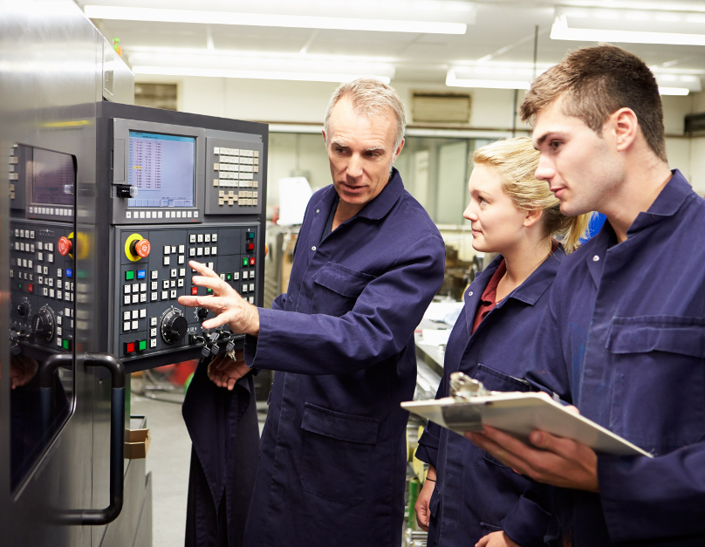
Precision Machining and Quality Control
Who is a potential Apprentice?
Leaving cert students.
Students who may have withdrawn from College
Existing Staff members
  Operators
  Experienced staff
  New Hires

Slide 16
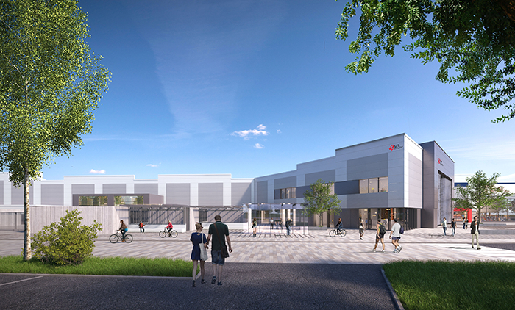
Coonagh Campus: A New Beginning

Slide 17

Coonagh Campus:
A New Beginning
CNC workshops Laboratories (x 2)
Metrology Laboratory
Material Engineering Laboratory
Engineering Workshops (x4)
Computer Aided Design Labs
Flat Teaching Space
Maker Space
Welding Workshop
Garage Facilities

