Slide 1
Limerick Institute of Technology
Precision Engineering Developments
at
LIT
Ciarán O’Loughlin
Precision Engineering Programme Leader
Lecturer
Department of Mechanical and Automobile Engineering.

Slide 2
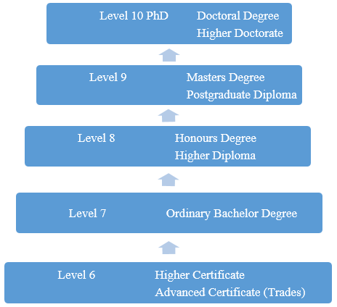
Technical University of the Shannon: Midlands Midwest
Third Level College:
Universities (7 in Ireland)
Institutes of Technology (14 in Ireland)
Move towards technical Universities.
PTMA: Now influential from
Level 6 to Level 8:
Next steps;
Precision machining and QC.
External Panel Shortly
Programmatic Review of Precision Programmes
Focus Group and Survey
Flexible Learning (evening) Programmes:
Time to re-evaluate offerings

Slide 3
Programme Structure: response to Industry
Level 8
B. Eng. Hons Precision Eng. Add-on
Level 8
B. Eng. Hons Precision Eng. Add-on
Level 8 Precision Engineering
Ab-initio
CAO
Year 4
Conversion Modules
Level 7
B. Eng. Precision Eng. Add-on
Level 7
B. Eng.
in Precision Engineering
CAO
Year 3
Flexible Learning (evenings)
CAD
CAM
CNC Prog
Eng. Tech
Metrology 6S
Maths & Sci.
Level 6 Proposed Apprenticeship
Precision Machinist and Quality Control
Level 6 Higher Certificate in Precision Engineering
Year 2
Year 1

Slide 4
Precision Engineering Level 8 B. Eng. Hons.
B. Eng. Precision Eng. Level 8 Year 4 (NEW)
Semester 1 | Semester 2
1. Computer Integrated Machining | 1. Automated Manufacturing systems
2. Additive Manufacturing Technology | 2. Design for Manufacture and Assembly
3. Project Management | 3. Management
4. Mechanics & Materials Testing | 4. Material Selection
5. Implementation of Lean and six Sigma Systems | 5. Quality Management Systems
6. Applied Research Project (Year long) Linked to Company (10 Credits)

Slide 5
Precision Engineering Level 8 B. Eng. Hons. Potential Part time 2021
B. Eng. Precision Eng. Level 8 Year 4 (NEW)
Semester 1 | Semester 2
1. Computer Integrated Machining | 1. Automated Manufacturing systems
2. Additive Manufacturing Technology | 2. Design for Manufacture and Assembly
3. Project Management | 3. Management
4. Mechanics & Materials Testing | 4. Material Selection
5. Implementation of Lean and six Sigma Systems | 5. Quality Management Systems
6. Applied Research Project (Year long) Linked to Company (10 Credits)

Slide 6
Level 8 B. Eng. Hons. Part time Introduction
Requires a cohort of students:
16 students per class.
Industry Support required:
Staff with Level 7 qualifications or equivalent in a related area can apply.
2 Days per week part time.
Part-time for 2021-22
Full time in 2022-23: Level 8 CAO students

Slide 7
Recruitment to Precision Programmes
Connect with second level schools and develop the talent pipeline
Scholarships/bursaries
Advanced Entry to second year, third or fourth year possible.
Trades (former Apprentices) progression to Degree level
Entry depends individual applications.
Summer work for Precision Engineering students.

Slide 8
Sweden-Ireland Collaboration Industry Credentials
Opened Discussion with SKTC (Sweden) to explore project ideas.
Potential Erasmus+ Projects
Sweden: Industry competence assessment
Belt level system
Irish Context
Ireland: Apprentice training system
Little or no academic recognition of industry competence formally
Collaboration in developing a link between the two.
Formalising Levels and standards

Slide 9
Apprenticeship Approval Process Precision Machining and Quality Control
Next steps
Complete Modules content
Complete Programme document
Review existing apprenticeships in detail for overlap
Request from HEA and SOLAS to prove the difference
between this trade and others.
International comparisons
Internal review within LIT: Completed
External review. As soon as possible. Next few weeks
Industry Training Order (Legislative requirement)
Recruitment of apprentices
✓
✓
✓
✓
✓
✓

Slide 10
Manufacturing Solutions 2022 Note the date: Not 2021!!

